Slide 1
SQL Final Project
Developing auction strategy for new IPL franchise by analyzing past IPL data to
create a strong and balanced squad.

Slide 2
Procedure of the Project
In this project we have been given a two data ipl_ball and ipl_matches as excel file.
We have to use the excel file to insert it on the pgAdmin SQL software.
After inserting the two tables we have to do the certain tasks which will be shown below.

Slide 3
Creating the Table and Inserting the Database
Query for Creating table and Inserting Database for IPL_Ball
CREATE TABLE ipl_ball ( id INT, inning INT, over INT, ball INT, batsman VARCHAR(100), non_striker VARCHAR(100), bowler VARCHAR(100), batsman_runs INT, extra_runs INT, total_runs INT, is_wicket BOOLEAN, dismissal_kind VARCHAR(50), player_dismissed VARCHAR(100), fielder VARCHAR(100), extras_type VARCHAR(50), batting_team VARCHAR(100), bowling_team VARCHAR(100) );
COPY ipl_ball FROM 'E:\SQL\PostgreSQL\Data\ipl_ball.csv' DELIMITER ',' CSV HEADER;

Slide 4
Query for Creating table and Inserting Database for IPL_Matches
CREATE TABLE ipl_matches (
id INT, city VARCHAR(100),date DATE,player_of_match VARCHAR(100),venue VARCHAR(100),neutral_venue BOOLEAN,team1 VARCHAR(100),team2 VARCHAR(100),
toss_winner VARCHAR(100),toss_decision VARCHAR(50),winner VARCHAR(100),
result VARCHAR(50),result_margin VARCHAR(50),eliminator VARCHAR(50),method VARCHAR(50),umpire1 VARCHAR(100),umpire2 VARCHAR(100));
COPY ipl_matches FROM 'E:\SQL\PostgreSQL\Data\ipl_matches.csv' DELIMITER ',' CSV HEADER;

Slide 5
Bidding on Batters Task 1
Query For Task 1
SELECT batsman,
SUM(total_runs) AS runs_scored,
COUNT(*) AS balls_faced,
(SUM(total_runs) * 100.0 / NULLIF(COUNT(*), 0)) AS strike_rate
FROM ipl_ball
WHERE NOT is_wicket -- Exclude wickets (assuming is_wicket is boolean)
GROUP BY batsman
HAVING COUNT(*) >= 500 -- Players who have faced at least 500 balls
ORDER BY strike_rate DESC -- Order by Strike Rate in descending order
LIMIT 10; -- Limit the result to 10 players

Slide 6
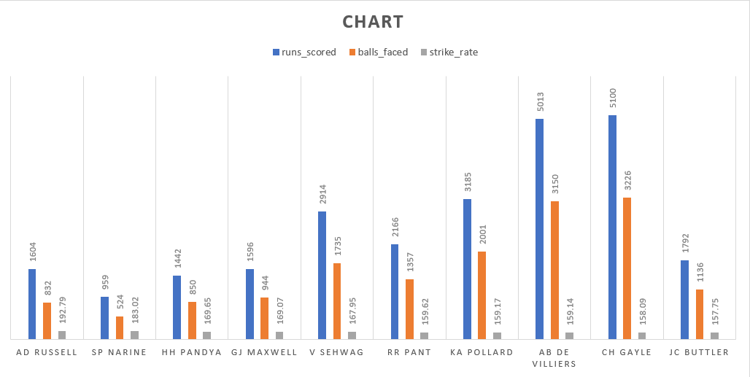
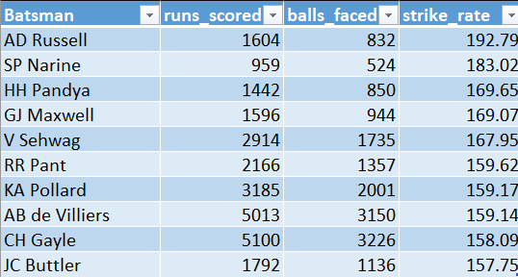
Table and Chart for Task 1

Slide 7
Bidding on Batters Task 2
Query For Task 2
WITH PlayerAverages AS (
SELECT a.batsman,
SUM(a.batsman_runs) AS total_batsman_runs,
COUNT(CASE WHEN a.is_wicket THEN 1 END) AS player_dismissed,
COUNT(DISTINCT EXTRACT(YEAR FROM b.date)) AS seasons,
(SUM(a.batsman_runs) * 1.0 / NULLIF(SUM(CASE WHEN a.is_wicket THEN 1 ELSE 0 END), 0)) AS average
FROM ipl_ball AS a
LEFT JOIN ipl_matches AS b ON a.id = b.id
GROUP BY a.batsman
)
SELECT batsman, total_batsman_runs, player_dismissed, seasons, average
FROM PlayerAverages
WHERE seasons > 2 -- Players who have played more than 2 seasons
ORDER BY average DESC
LIMIT 10;

Slide 8
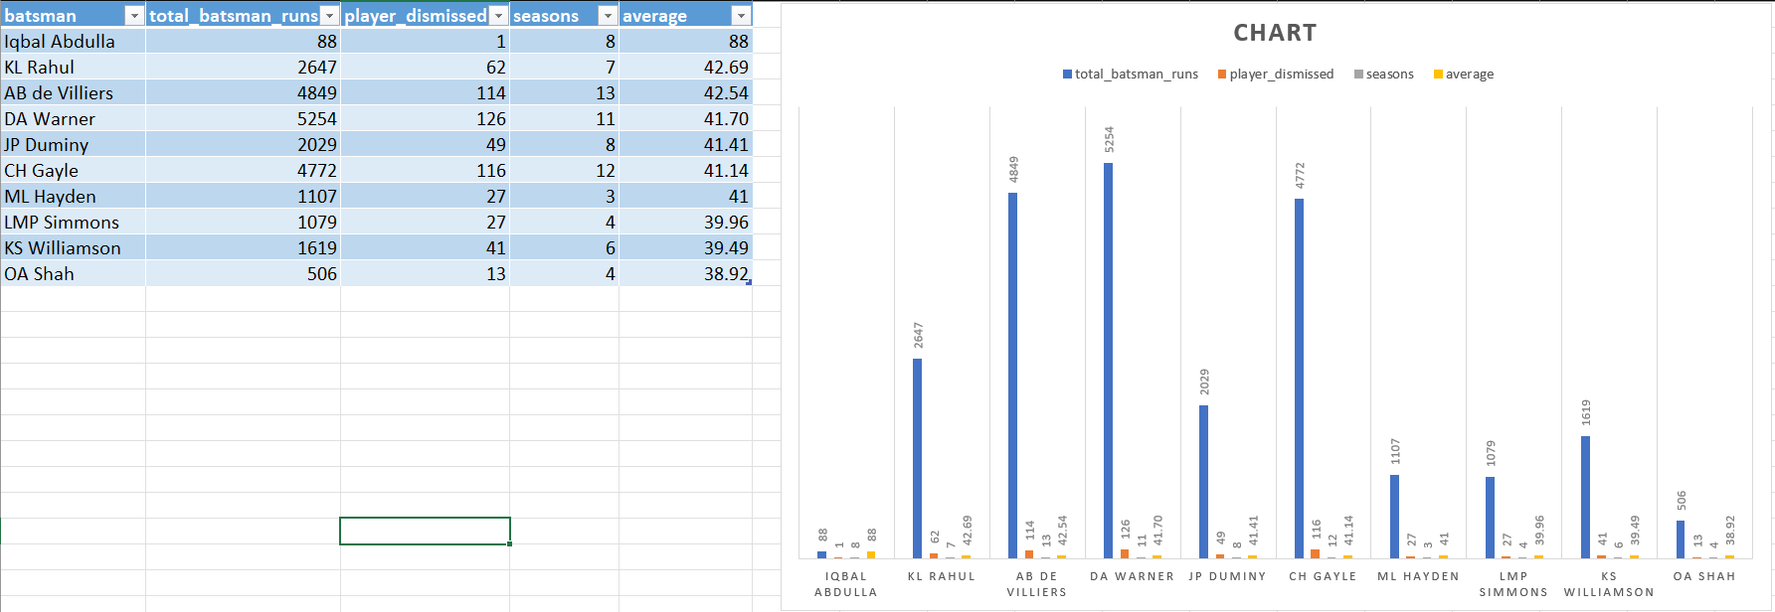
Table and Chart for Task 2

Slide 9
Bidding on Batters Task 3
Query For Task 3
SELECT batsman, total_runs, total_runs_in_boundaries, boundary_percentage
FROM
(
SELECT
a.batsman,
COUNT(DISTINCT EXTRACT(year FROM b.date)) AS season,
SUM(a.batsman_runs) AS total_runs, SUM(CASE WHEN a.batsman_runs IN (4, 6) THEN a.batsman_runs ELSE 0 END) AS total_runs_in_boundaries,
SUM(CASE WHEN a.batsman_runs IN (4, 6) THEN 1 ELSE 0 END) AS total_boundaries,
(SUM(CASE WHEN a.batsman_runs IN (4, 6) THEN a.batsman_runs ELSE 0 END) * 1.0 / SUM(a.batsman_runs)) * 100 AS boundary_percentage
FROM ipl_ball AS a
FULL JOIN ipl_matches AS b ON a.id = b.id
GROUP BY a.batsman
ORDER BY boundary_percentage DESC
) AS c
WHERE c.season > 2
LIMIT 10;

Slide 10
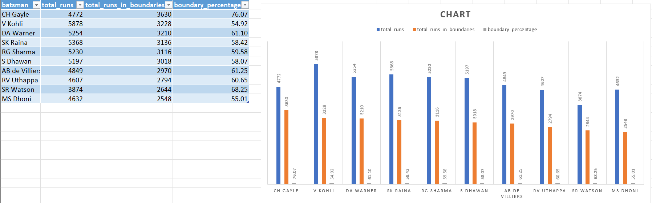
Table and Chart for Task 3

Slide 11
Bidding on Bowlers Task 4
Query For Task 4
SELECT bowler,
COUNT(*) AS balls_bowled,
SUM(total_runs) AS runs_conceded,
SUM(CASE WHEN extras_type = 'wides' THEN 1 ELSE 0 END) AS wides,
SUM(CASE WHEN extras_type = 'noballs' THEN 1 ELSE 0 END) AS no_balls,
SUM(CASE WHEN is_wicket THEN 1 ELSE 0 END) AS wickets_taken,
SUM(total_runs) * 1.0 / COUNT(*) AS economy_rate
FROM ipl_ball
WHERE extras_type NOT IN ('byes', 'legbyes')
GROUP BY bowler
HAVING COUNT(*) >= 500
ORDER BY economy_rate ASC
LIMIT 10;

Slide 12
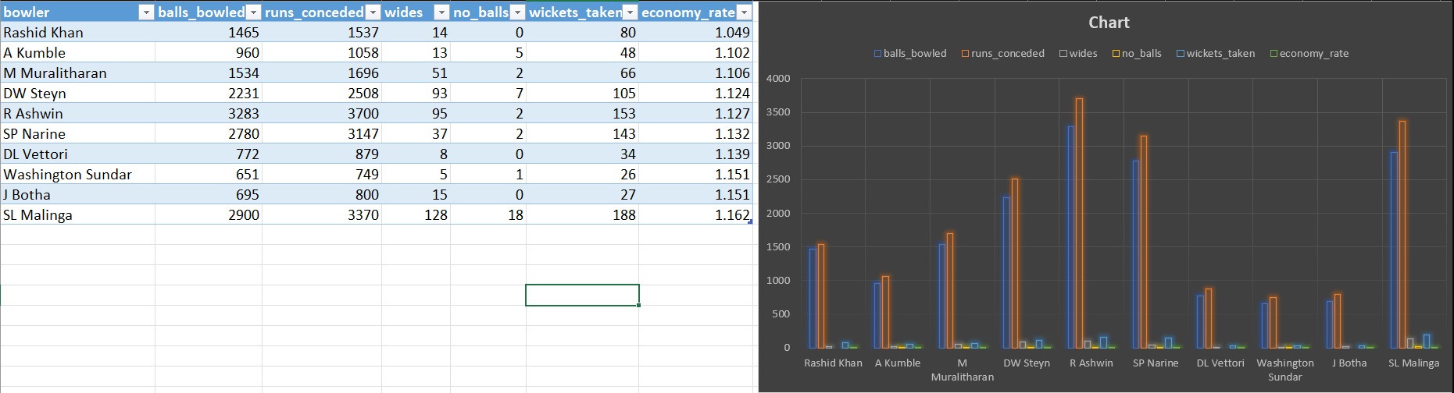
Table and Chart for Task 4

Slide 13
Bidding on Bowlers Task 5
Query for Task 5
WITH BowlerStats AS (
SELECT
bowler,
COUNT(*) AS balls_bowled,
SUM(CASE WHEN is_wicket THEN 1 ELSE 0 END) AS wickets_taken,
ROUND(COUNT(*) * 1.0 / SUM(CASE WHEN is_wicket THEN 1 ELSE 0 END), 2) AS strike_rate
FROM ipl_ball
GROUP BY bowler
HAVING COUNT(*) >= 500
)
SELECT *
FROM BowlerStats
ORDER BY strike_rate ASC
LIMIT 10;

Slide 14
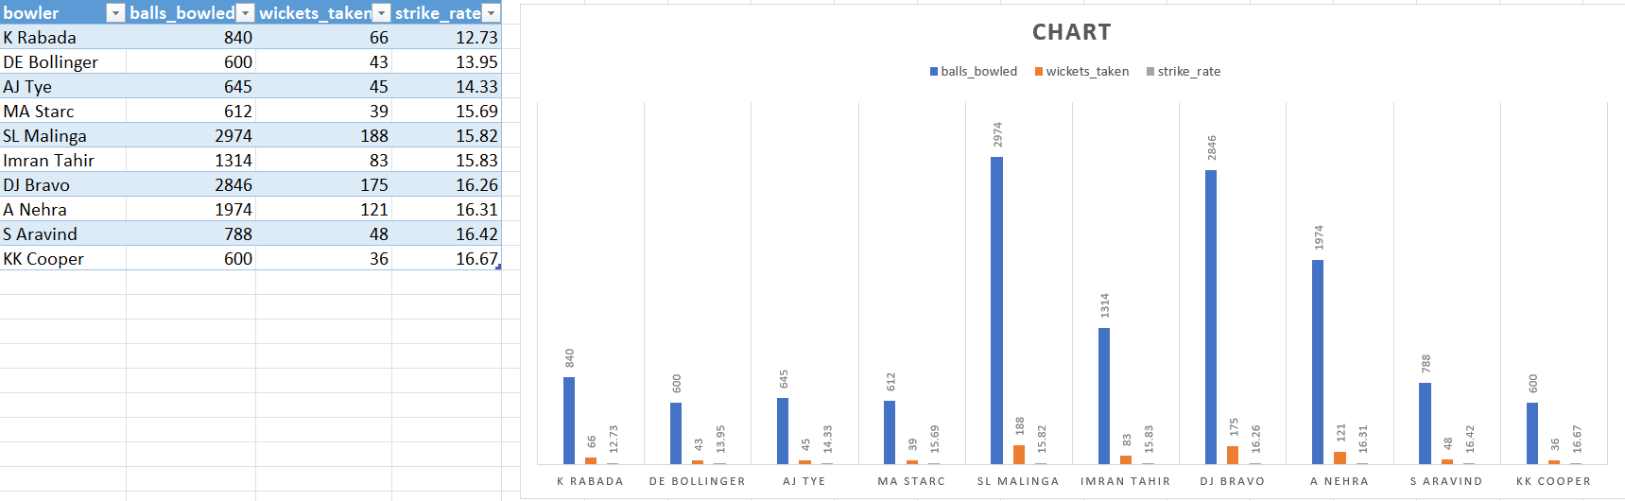
Table and Chart for Task 5

Slide 15
All Rounders Task 6
Query for Task 6
SELECT a.*, b.* FROM
(SELECT
batsman AS player,
COUNT(ball) AS total_balls_faced,
SUM(batsman_runs) AS total_runs_scored,
ROUND (CAST (SUM(batsman_runs) AS decimal)/COUNT (ball)*100,2) AS batting_strike_rate
FROM ipl_ball
GROUP BY batsman
HAVING COUNT (ball) > 500
ORDER BY batting_strike_rate DESC
)
INNER JOIN
(SELECT
ROUND (CAST (COUNT (ball) AS decimal)/SUM(CAST(is_wicket AS INT)), 2) AS bowling_strike_rate,
SUM(total_runs) AS total_runs_conceded,
COUNT (ball) AS total_deliveries,
SUM(CAST(is_wicket AS INT)) AS total_wickets_taken,
bowler AS player
FROM ipl_ball
GROUP BY bowler
HAVING COUNT (ball) > 300
ORDER BY bowling_strike_rate
) AS b ON a.player = b.player
limit 10;

Slide 16
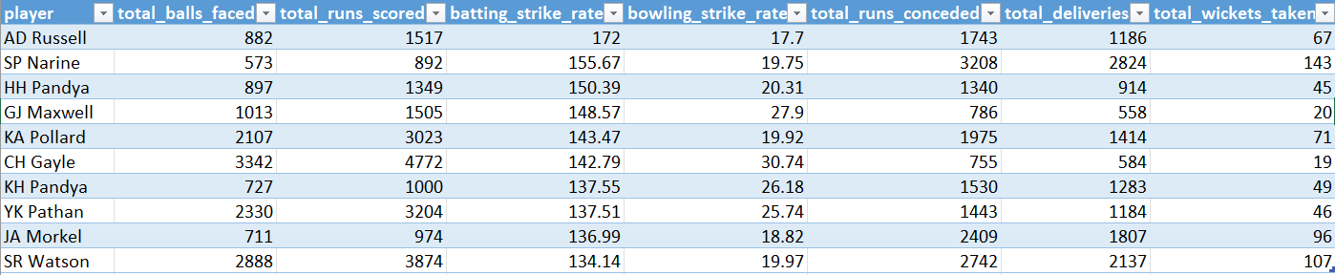
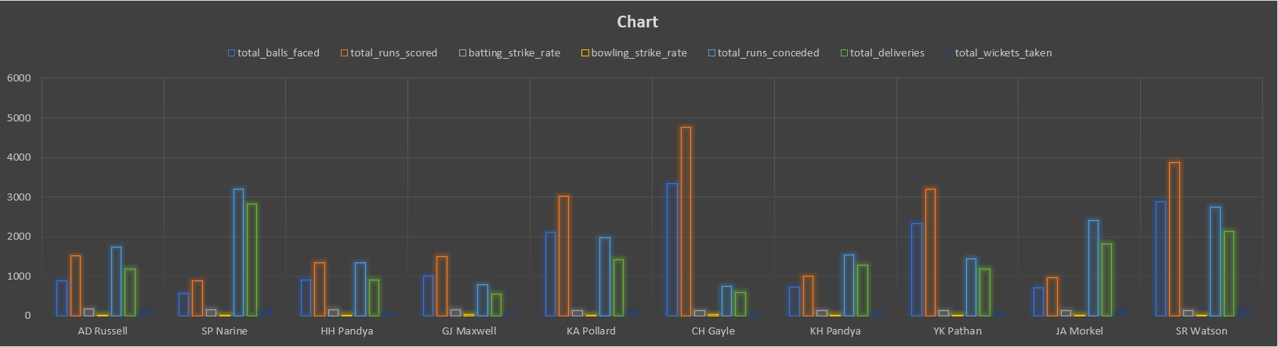
Table and Chart for Task 6

Slide 17
Criteria for choosing Wicketkeepers
Some of my own criteria for choosing best two wicketkeepers will be-
I will prioritize wicketkeepers who not have high strike rate but they are flawless and consistence in their batting performance, hence minimizing the rise of quick dismissals and contritube consistently to the team’s total run.
I will prioritize wicketkeeping proficiency who focus on their ability to take catches and effect stumpings efficiently.
I will consider their overall fielding abilities, including their agility, reflexes and capability to contribute to the team apart from their primary role as wicketkeepers.

Slide 18
I will look into those players who has a great level of awarness and understanding of the match situations and has the ability to make a quick decision depending on the match situations.
Regardless of all the criteria I mention on other points the player should have good leadership qualities as it helps to enhance the effectiveness of a wicketkeeper, especially in guiding the bowlers , motivating the team and makes some strategic decisions for the gameplay.
I will look into those players who are physically fit and they should be capable of showing consistence performance and aid the team to victory.

Slide 19

Additional Questions for Final Project
Q1. Get the count of cities that have hosted an IPL match.
select count(distinct city) from "ipl_matches";
Q.2 Create table deliveries_v02 with all the columns of the table ‘deliveries’ and an additional column ball_result containing values boundary, dot or other depending on the total_run (boundary for >= 4, dot for 0 and other for any other number).
CREATE TABLE deliveries_v02 AS
SELECT *,
CASE
WHEN total_runs >= 4 THEN 'boundary'
WHEN total_runs = 0 THEN 'dot'
ELSE 'other'
END AS ball_result
FROM ipl_ball;

Slide 20
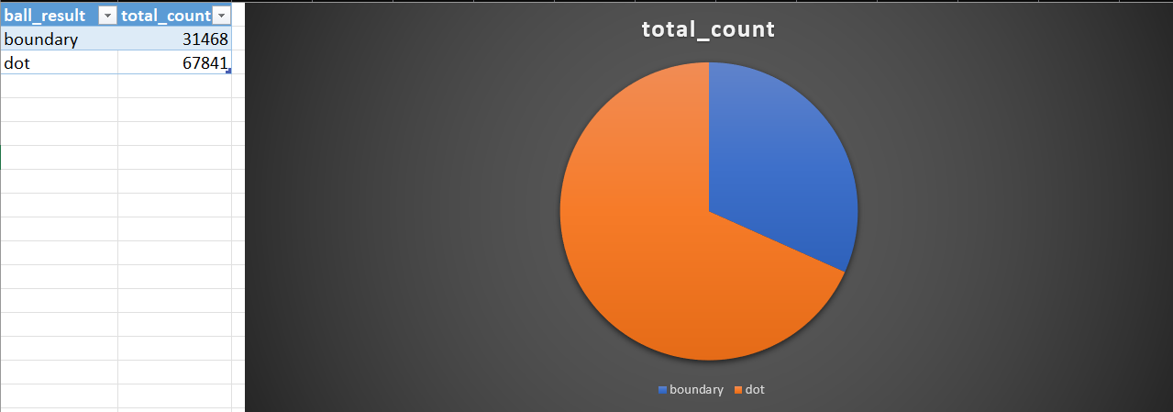
Q.3 Write a query to fetch the total number of boundaries and dot balls from the deliveries_v02 table.
SELECT
ball_result,
COUNT(*) AS total_count
FROM
deliveries_v02
WHERE
ball_result IN ('boundary', 'dot')
GROUP BY
ball_result;

Slide 21
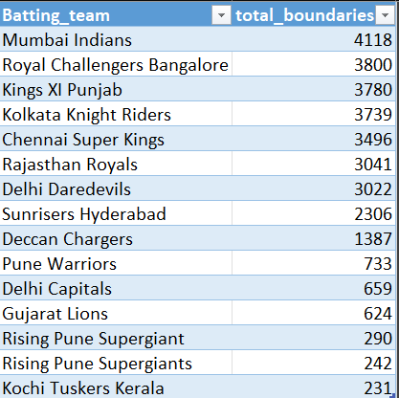
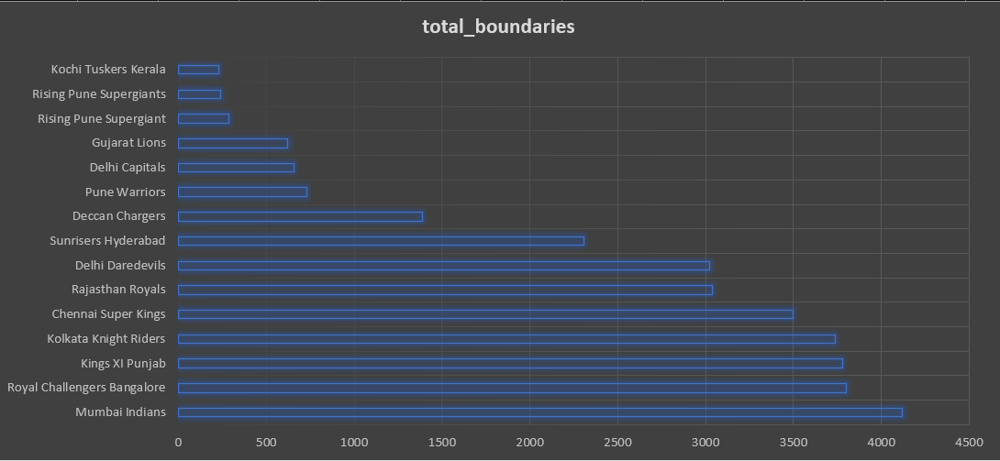
Q4. Write a query to fetch the total number of boundaries scored by each team from the deliveries_v02 table and order it in descending order of the number of boundaries scored.
SELECT
batting_team,
COUNT(*) AS total_boundaries
FROM
deliveries_v02
WHERE
ball_result = 'boundary'
GROUP BY
batting_team
ORDER BY
total_boundaries DESC;

Slide 22
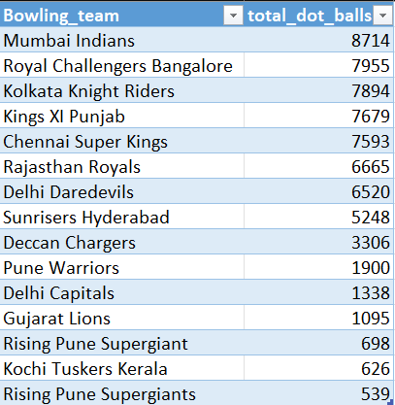
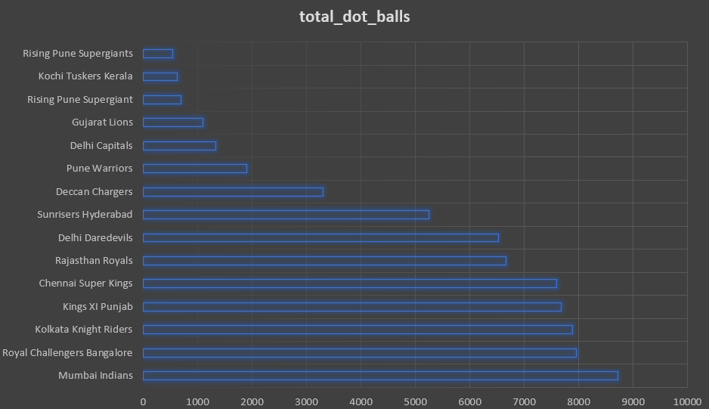
Q5. Write a query to fetch the total number of dot balls bowled by each team and order it in descending order of the total number of dot balls bowled.
SELECT
bowling_team,
COUNT(*) AS total_dot_balls
FROM
deliveries_v02
WHERE
ball_result = 'dot'
AND bowling_team IS NOT NULL
GROUP BY
bowling_team
ORDER BY
total_dot_balls DESC;

Slide 23
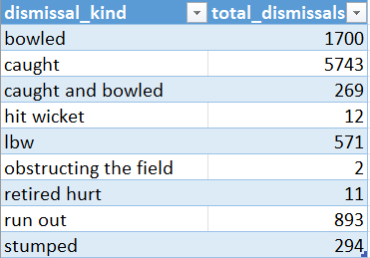
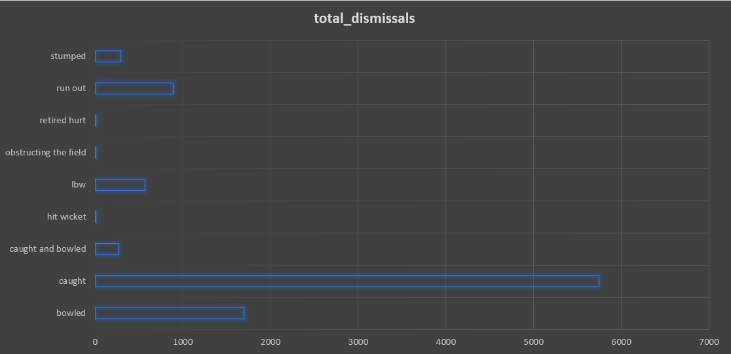
Q6. Write a query to fetch the total number of dismissals by dismissal kinds where dismissal kind is not NA.
SELECT
dismissal_kind,
COUNT(*) AS total_dismissals
FROM
deliveries_v02
WHERE
dismissal_kind IS NOT NULL
AND dismissal_kind != 'NA'
GROUP BY
dismissal_kind;

Slide 24
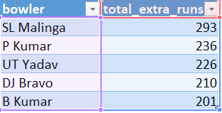
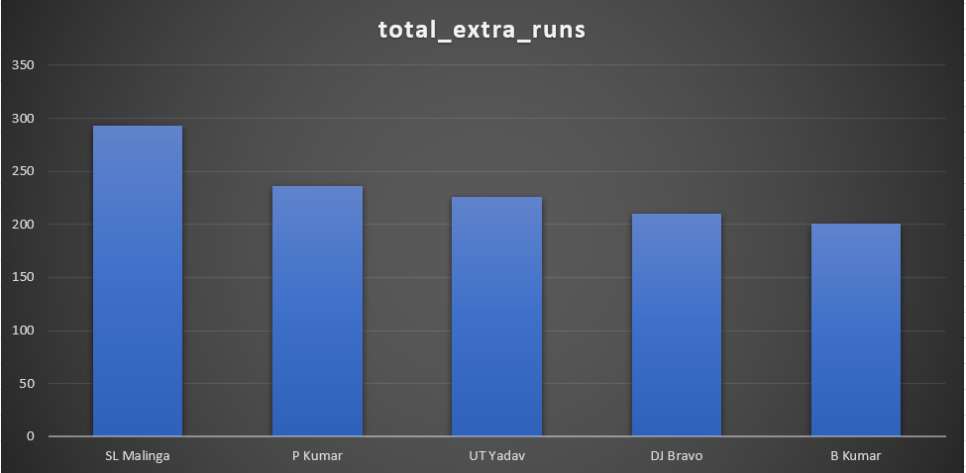
Q7. Write a query to get the top 5 bowlers who conceded maximum extra runs from the deliveries table.
SELECT
bowler,
SUM(extra_runs) AS total_extra_runs
FROM
deliveries_v02
GROUP BY
bowler
ORDER BY
total_extra_runs DESC
LIMIT 5;

Slide 25
Q8. Write a query to create a table named deliveries_v03 with all the columns of deliveries_v02 table and two additional column (named venue and match_date) of venue and date from table matches.
create table deliveries_v03 as
(select a.*,b.venue,b.date as match_date
from deliveries_v02 as a
left join "ipl_matches" as b
on a.id = b.id);
select * from deliveries_v03;

Slide 26
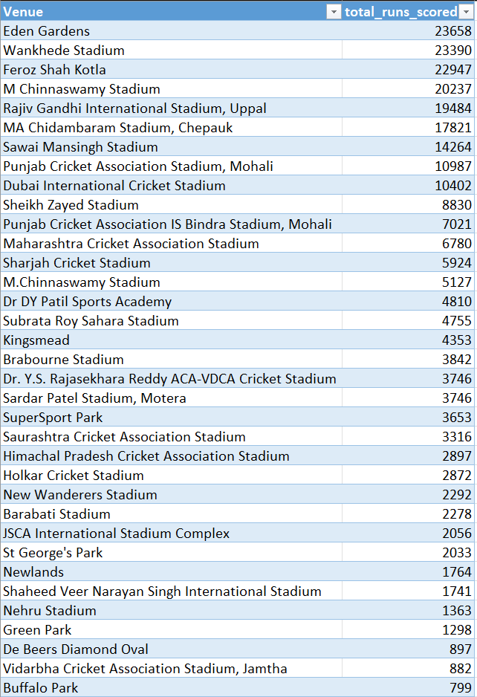
Q9. Write a query to fetch the total runs scored for each venue and order it in the descending order of total runs scored.
SELECT
venue,
SUM(total_runs) AS total_runs_scored
FROM
deliveries_v03
GROUP BY
venue
ORDER BY
total_runs_scored DESC;

Slide 27
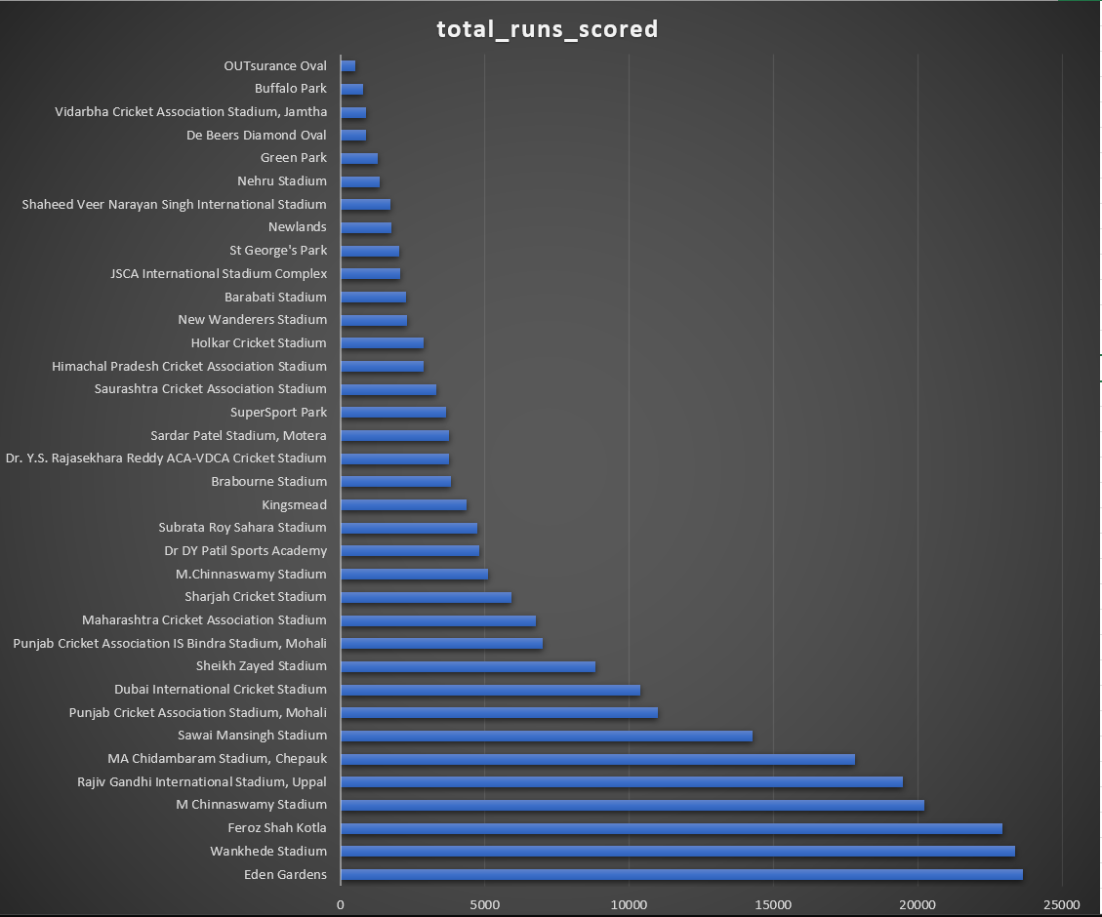

Slide 28
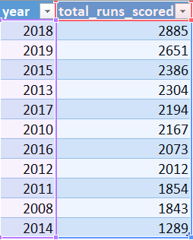
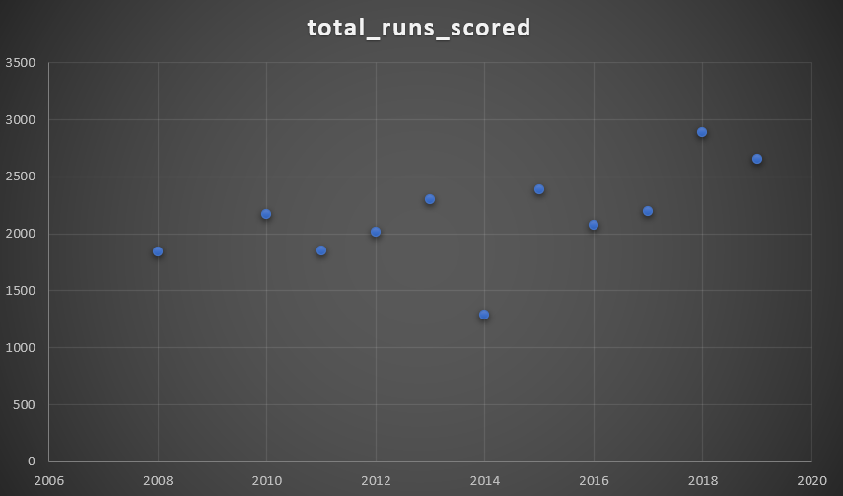
Q10. Write a query to fetch the year-wise total runs scored at Eden Gardens and order it in the descending order of total runs scored.
SELECT
EXTRACT(YEAR FROM match_date) AS year,
sum(total_runs) AS total_runs_scored
FROM
deliveries_v03
WHERE
venue = 'Eden Gardens'
GROUP BY
year
ORDER BY
total_runs_scored DESC;

Slide 29
THANK YOU

